Slide 1
Parametric tests: Comparing several means: ANOVA
When you have more than two groups of data, then you may want to compare those (multiple) means that comes from multiple groups of data.
For example. Viagra is a sexual stimulant (used to treat impotence) that broke into the black market under the belief that it will make someone a better lover. Suppose we tested this belief by taking three groups of participants and administering one group with a placebo (such as a sugar pill), one group with a low dose of Viagra and one with a high dose.
Question? Whether the there is differential effect of Viagra on libido in terms of its dose?

Slide 2
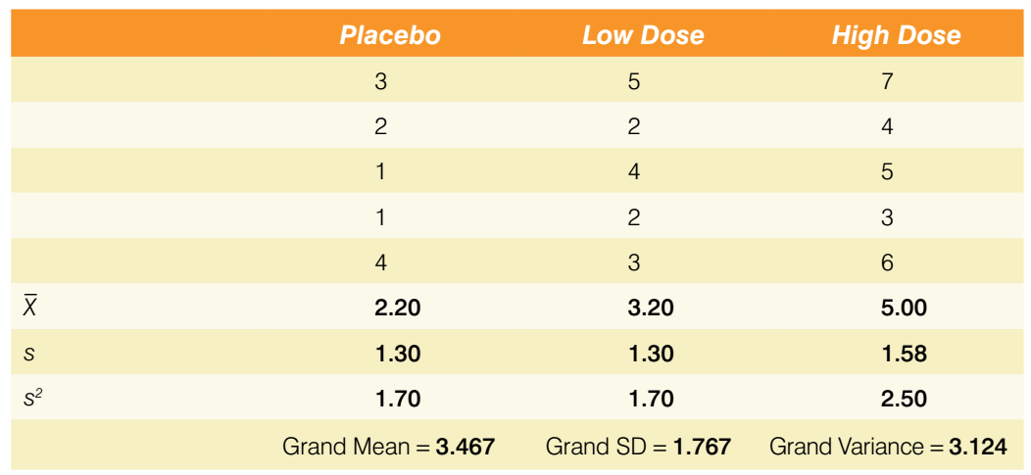
Data (fictitious)
For example two hypothesis can be generated such as any dose of Viagra may change the libido compared to the placebo group as fist hypothesis and a high dose of Viagra should increase libido more than a low dose.

Slide 3
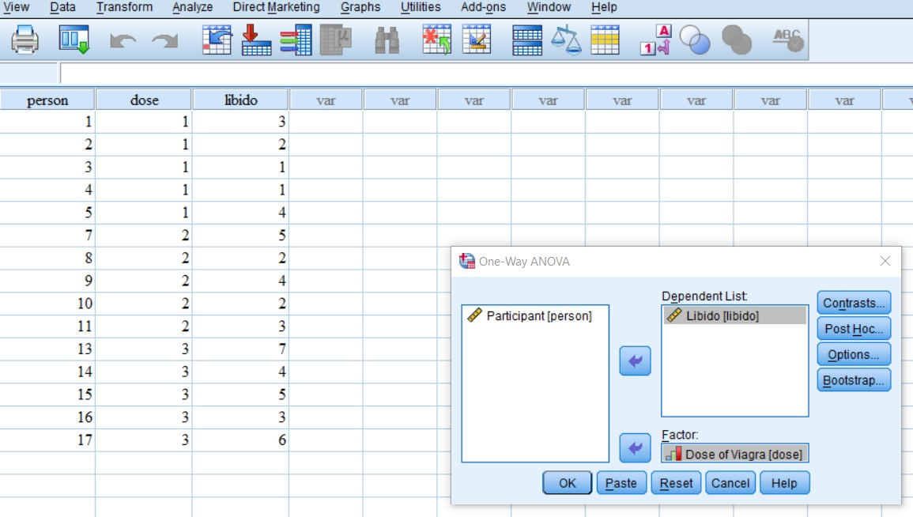
Running the analysis

Slide 4
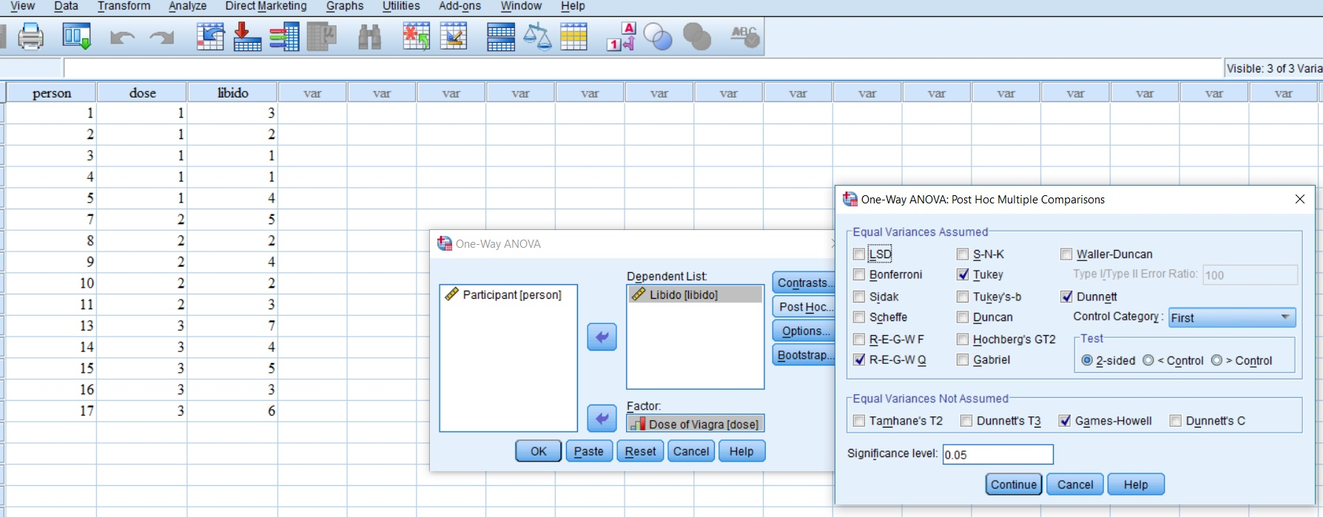
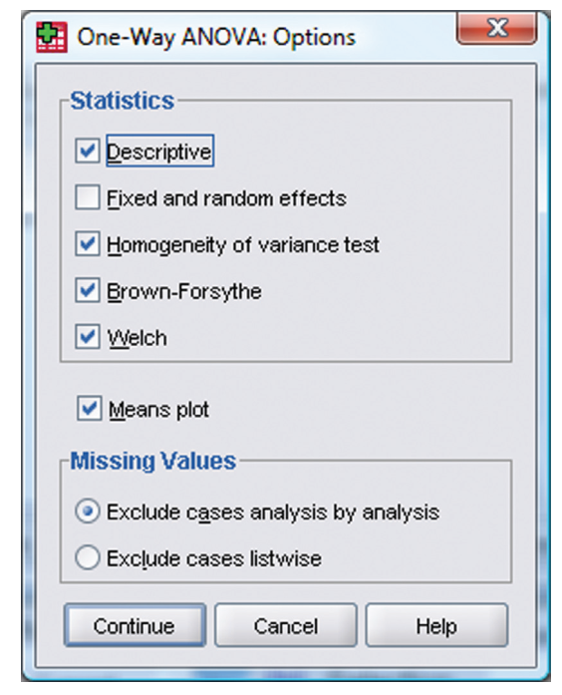
Post hos test

Slide 5
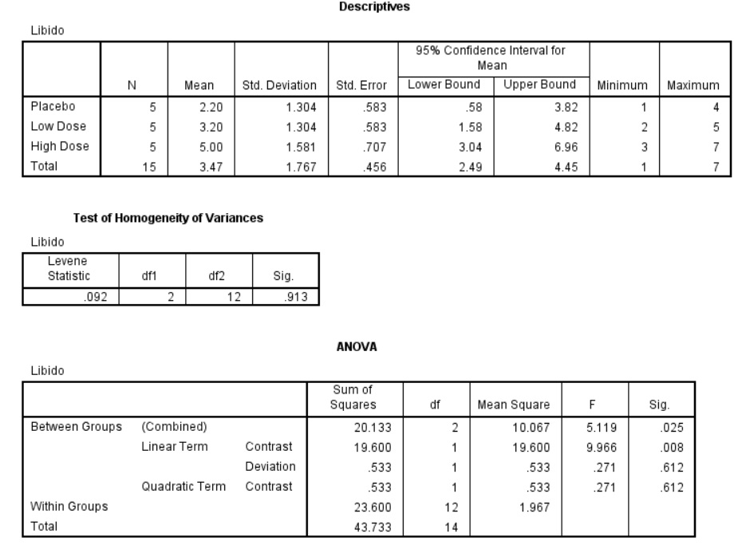

Slide 6
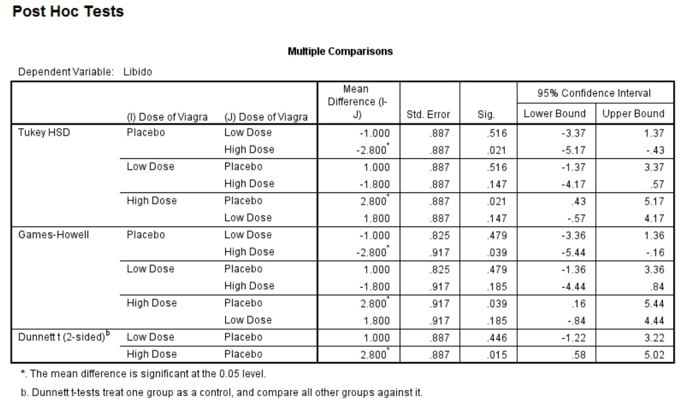

Slide 7
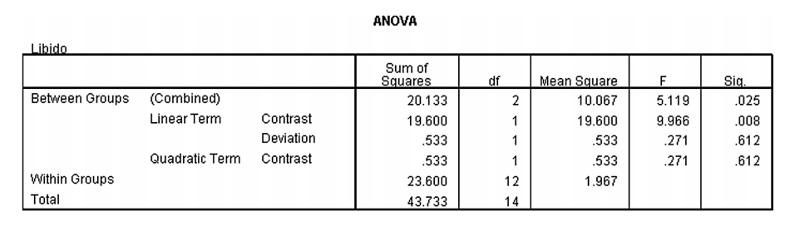
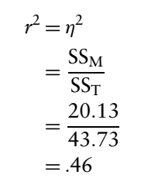

Calculating effect size
How to report ANOVA result:
There was a significant effect of Viagra on levels of libido, F(2, 12) = 5.12, p < .05, ω = .60.

